Slide 1

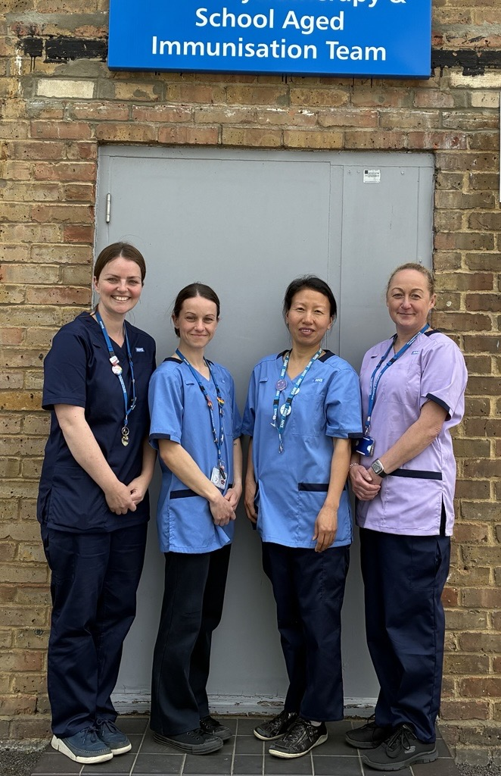


Information for
Young People
Immunisation Team
Welcome from the Bracknell Immunisation team
We are a skilled Immunisation team working across Bracknell, delivering vaccinations to children aged 5–16 (Reception to Year 11) in schools and community venues across Berkshire. We have extensive experience supporting children who may be anxious or have additional needs. Our team can book clinics, check vaccine status, and provide advice and information. If you have any questions, please contact us using the details below.
Vaccinations offered in school:
Meningitis
ACWY due in Year 9
Flu vaccine due in Reception up to Year 11
We can provide home visits too!
Tetanus/Diphtheria and Polio due in Year 9
Human Papilloma Virus due in
Year 8
Measles/Mumps and Rubella – 2 doses
Men ACWY
cypf.berkshirehealthcare.nhs.uk
0300 365 0077 (Mon to Fri 8am – 4pm)
NHSimmunisations-bracknell@berkshire.nhs.uk

